Slide 1
From use cases to scenario diagram (in UML)

Slide 2
Exercise
I am the manager of a theatre.
I want to create an automated movie ticket machine.
You are analysts who need to describe
what the customer wants as a set of use cases
Simplifying assumptions:
  One movie showing at a time
  Movie time is same every day, only one time, same price
  Only manager can change/add movie
  Customer can only buy tickets
Who or what are the actors?
What are the use cases (goals of actors)?

Slide 3
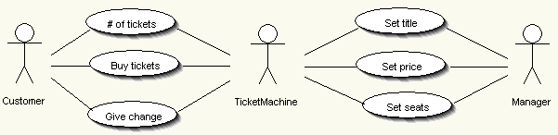
Use case diagram for Movie Ticket Machine
Why are there three Actors?
Why three use cases for Customer?
Which use cases look easy to write?

Slide 4
Use cases for Manager
Use case: Set title
Actors: Manager, Machine
1. Manager requests a change of movie title
2. Machine asks manager for new movie title
3. Manager enters movie title

Slide 5
Use cases for Manager
Use case: Set price
Actors: Manager, Machine
1. Manager requests a change of ticket price
2. Machine asks manager for new price for movie title
3. Manager enters ticket price
Alternatives: Invalid price
If manager enters price below $1 or greater than $10
3a. Machine asks manager to reenter price

Slide 6
Use cases for Manager
Use case: Set seats
Actors: Manager, Machine
1. Manager requests a change in number of seats
2. Machine asks manager for number of seats in theatre
3. Manager enters number of seats
Alternatives: Invalid number of seats
If manager enters number less than 20 or greater than 999
3a. Machine asks manager to reenter number of seats

Slide 7
Use cases for Customer
Use case: # of tickets
Actors: Customer, Machine
1. Customer enters number of tickets
2. Machine displays total balance due
Alternative: Customer wants zero tickets
At step 1, customer enters zero tickets
1a. Display thank you message
1b. Set balance to $0.0

Slide 8
Use cases for Customer
Use case: Return change to customer
Actors: Customer, Machine
1. Customer requests change
2. Machine dispenses money
3. Machine updates customer balance

Slide 9
Use cases for Customer
Use case: Buy tickets
Actors: Customer, Machine
1. Customer requests tickets
2. Machine tells customer to put
balance due in money slot
3. Customer enters money in money slot
4. Machine updates customer balance
5. Customer requests tickets
6. Machine prints tickets
7. Machine updates number of seats
Alternative: Insufficient seats
At step 1, if number of tickets requested
is less than available seats,
1a. Display message and end use case
Alternative: Insufficient funds
At step 5, if money entered < total cost,
5a. Display insufficient amount entered
5b. Go to step 3

Slide 10
Activity diagrams in UML 2.0
From use cases
to activity diagram (UML)

Slide 11
Contents
Introduction to UML 2.0 Activity Diagrams
Concepts of Action, Pins and Activity
Description of activity nodes and activity edges

Slide 12
Activity diagrams
Useful to specify software or hardware system behaviour
Based on data flow models – a graphical representation (with a Directed Graph) of how data move around an information system
[order reject]
Receive
Fill
Ship
Close
Order
Order
Order
Order
[order
accepted]
Send
Invoice
Make Payment
Accept
Invoice
Payment

Slide 13
Some definitions
Flow: permits the interaction between two nodes of the activity diagram (represented by edges in activity diagram)
State: a condition or situation in the life of an object during which it satisfies some conditions, performs some activities, or waits for some events
Type: specifies a domain of objects together with the operations applicable to the objects (also none); includes primitive built-in types (such as integer and string) and enumeration types
Token: contains an object, datum, or locus of control, and is present in the activity diagram at a particular node; each token is distinct from any other, even if it contains the same value as another
Value: an element of a type domain

Slide 14


Actions
The fundamental unit of executable functionality in an activity
The execution of an action represents some transformations or processes in the modeled system (creating objects, setting attribute values, linking objects together, invoking user-defined behaviours, etc.)
Description of the action behaviour

Slide 15
Conditions to start and end actions
An action can start only if:
  all non-stream inputs have arrived (or at least one stream input if there are only stream inputs)
The action can finish only if:
  all inputs have arrived (streaming inputs included)
  all non-stream and non-exception outputs (or an exception outputs) have been provided
Prevent deadlock: an input pin of an action cannot accept tokens until all the input pins of the action can accept them

Slide 16
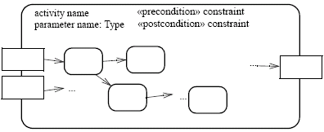


Activities
An activity is the specification of parameterized behaviour as the coordinated sequencing of subordinate units whose individual elements are actions
Uses parameters to receive and provide data to the invoker
Activity nodes
Parameter name
Activity edges
Output parameter
Input parameter
Parameter name
Parameter name
An action can invoke an activity to describe its action more finely
This action invokes the activity Fill Order

Slide 17


Activity nodes
Three type of activity nodes:
  Action nodes: executable activity nodes; the execution of an action represents some transformations or processes in the modeled system (already seen)
  Control nodes: coordinate flows in an activity diagram between other nodes
  Object nodes: indicate an instance of a particular object, may be available at a particular point in the activity (i.e Pins are object nodes)

Slide 18





Activity edges (1)
Are directed connections
They have a source and a target, along which tokens may flow
Any number of tokens can pass along the edge, in groups at one time, or individually at different times
Weight: determines the minimum number of tokens that must traverse the edge at the same time
In this example we use a non-constant weight: an invoice for a particular job can only be sent when all of its tasks have been completed

Slide 19




Activity edges (2)
Two kinds of edges:
  Control flow edge - is an edge which starts an activity node after the completion of the previous one by passing a control token
  Object flow edge - models the flow of values to or from object nodes by passing object or data tokens
Notation without activity nodes
Notation without activity nodes

Slide 20
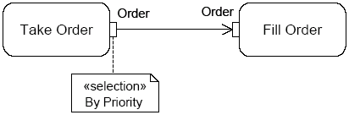
Example – go to Genova
Go to Heaven/Hell ;)
«local precondition»
Have a license
Car crash
Turn on the car
[else]
Fill up with fuel
To motorway tollgate
Catch the ticket
[on car]
[the tank is full]
Get
luggage
ready
Go home with the car
Pay the ticket
Exit to Genova tollgate
[on train]
Go to the station with a friend
Buy the ticket
Obliterate the ticket
Catch the train
Go to Heaven/
Hell ;)
The train
derail
The friend goes home
When the train
arrives
to Genova
Go home with bus
Get off the train
[else]
Study for 5 minutes
[Genova is a long way]

Slide 21
Bibliography
Object Management Group, “UML 2.0 Superstructure Specification,” http://www.omg.org/cgi-bin/doc?ptc/03-08-02, August 2003
Conrad Bock (U.S. NIST), “UML 2 Activity and Action Models,” in Journal of Object Technology, vol. 2, no. 4, July-August 2003, pp. 43-53, http://www.jot.fm/issues/issue_2003_07/column3
Conrad Bock (U.S. NIST), “UML 2 Activity and Action Models, Part 2: Actions,” in Journal of Object Technology, vol. 2, no. 5, September-October 2003, pp. 41-56, http://www.jot.fm/issues/issue_2003_09/column4
Conrad Bock (U.S. NIST), “UML 2 Activity and Action Models, Part 3: Control Nodes,” in Journal of Object Technology, vol. 2, no. 6, November-December 2003, pp. 7-23, http://www.jot.fm/issues/issue_2003_11/column1
Conrad Bock (U.S. NIST), “UML 2 Activity and Action Models, Part 4: Object Nodes,” in Journal of Object Technology, vol. 3, no. 1, January-February 2004, pp. 27-41, http://www.jot.fm/issues/issue_2003_11/column1
Gruppo Yahoo su UML, http://groups.yahoo.com/group/uml-forum/

Slide 22

Control nodes – initial nodes
In an activity the flow starts in initial nodes, that return the control immediately along their outgoing edges
If there are more than one initial node, a control token is placed in each initial node when the activity is started, initiating multiple flows
If an initial node has more than one outgoing edge, only one of these edges will receive control, because initial nodes cannot duplicate tokens
A or B ?

Slide 23

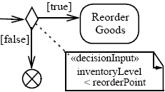
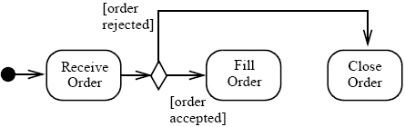

Control nodes – decision nodes
Route the flow to one of the outgoing edges (tokens are not duplicated)
Guards are specified on the outgoing edges or with the stereotype «decisionInput»
There is also the predefined guard [else], chosen only if the token is not accepted by all the other edges
If all the guards fail, the token remains at the source object node until one of the guards accept it

Slide 24

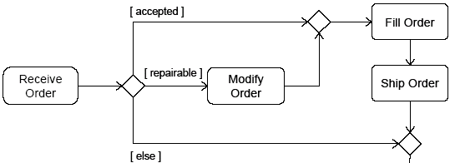

Control nodes – merge nodes
Bring together multiple alternate flows
All controls and data arriving at a merge node are immediately passed to the outgoing edge
There is no synchronization of flows or joining of tokens

Slide 25
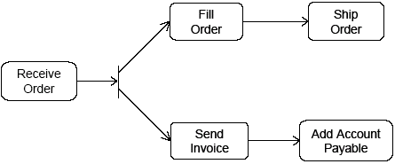

Control nodes – fork nodes
Fork nodes split flows into multiple concurrent flows (tokens are duplicated)
State machine forks in UML 1.5 required synchronization between parallel flows through the state machine RTC step (it means that the first state in each branch is executed, then the second one, etc.)
UML 2.0 activity forks model unrestricted parallelism

Slide 26

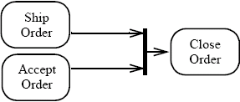
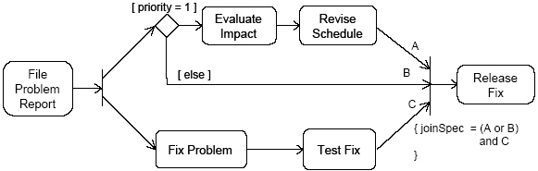
Control nodes – join nodes
Join nodes synchronize multiple flows
Generally, controls or data must be available on every incoming edge in order to be passed to the outgoing edge, but user can specify different conditions under which a join accepts incoming controls and data using a join specification

Slide 27
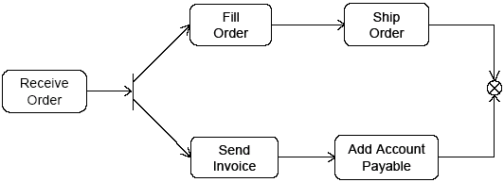


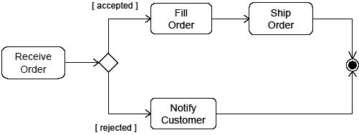
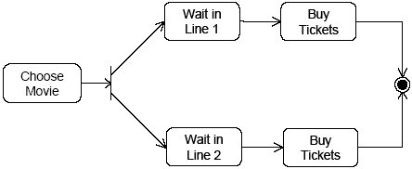
Control nodes – final nodes
Flow final:
  destroys the tokens that arrive into it
  the activity is terminated when all tokens in the graph are destroyed
Final node:
  the activity is terminated when the first token arrives
intentional race between flows

Slide 28

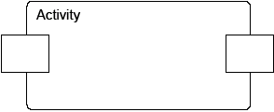
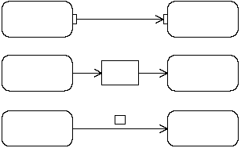



Object nodes
Hold data temporarily while they wait to move through the graph
Specify the type of values they can hold (if no type is specified, they can hold values of any type)
Can also specify the state of the held objects
There are four kinds of object nodes:
Central Buffer Nodes
Data Store Nodes
Activity Parameter Nodes
Pins
(three differents notations)

Slide 29

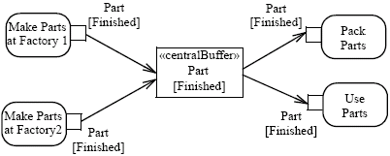
Object nodes – centralBuffer
A central buffer node is an object node that manages flows from multiple sources and destinations (as opposed to pins and parameters)
Acts as a buffer for multiple input flows and output flows
Is not tied to an action like pins, or to an activity like activity parameter nodes
The centralBuffer node collects the object Parts, and each Part can be used or packet (but not both)

Slide 30

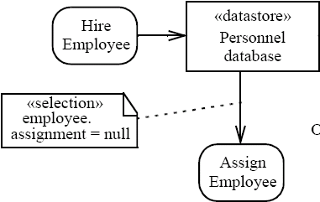
Object nodes – datastore
Is a specific central buffer node which stores objects persistently
Keeps all tokens that enter into it
Tokens chosen to move downstream are copied so that tokens never leave the data store
If arrives a token containing an object already present in the data store, this replaces the old one
Tokens in a data store node cannot be removed (they are removed when the activity is terminated)
Notes:
Hire = assumere

Slide 31
From use cases to class diagram (in UML)

Slide 32
Domain analysis
Domain analysis understands the customer’s problem—by identifying the classes comprising a problem domain.
Result of OO analysis is a UML class diagram modeling the concepts and relationships in problem domain.
Separation of concerns principle: Keep problem domain model distinct from user interface or database modeling. Why?

Slide 33
From use cases to classes
1. Identify classes of objects in the problem description
Heuristic: nouns may be classes
But: verbs can be nominalized
(iterate->iteration, withdraw->withdrawal)
Heuristic: does it store state (does it have attributes)
and does it have operations?

Slide 34
From use cases to classes
2. Identify attributes of each class:
What characteristics are important to keep track of?
What data must be maintained or remembered during object’s life?

Slide 35
From use cases to classes
3. Identify methods of each class:
What actions must the object be able to perform?
What actions can be done to the object (e.g., to change its state)?
Use cases may correspond to methods

Slide 36
From use cases to classes
4. Identify parameters and return types of methods:
What input does a method need from caller? These are parameters.
Does the method generate a result value?
The return type must match the data type of data to be returned.

